Slide 1






COMMUNICATION
Project: Computer Network for Children’s Palace from Iasi
Students: Calugareanu Beatrice
Vacalie Dragos
Group: 5311
BLUEPRINT
WHO ARE THEY?
BUDGET
NETWORKING

Slide 2




WHO ARE THEY?

Slide 3
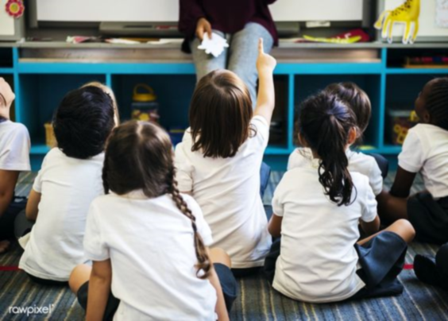
Activity Profile
The main activity profile of the Children’s Palace is education and also they are holding theatrical activities such as creation, artistic interpretation or literature.
The Palace hosts its activity in around 100 clubs divided in 6 domains:
Visual arts
Civic culture
Technical and scientific
Technical applications
Sports and tourism
Art

Slide 4

Description
Children's Palace activity implies a specific instructive-educational approach, through which the children increases their knowledge from different domains, facilitating the development and exercise of skills according to the vocation and option of the children.
The activities can be organized together with educational institutions, ONGs and other profile institutions.

Slide 5

Future Plans
For the future the Children’s Palace plan is Increasing their staff number by 50 more people, having in total 157 staff members, and extending their activities in a new building as big as the actual one, or bigger, in the city of Iasi.

Slide 6
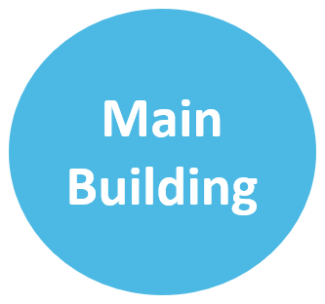


BLUEPRINT

Slide 7
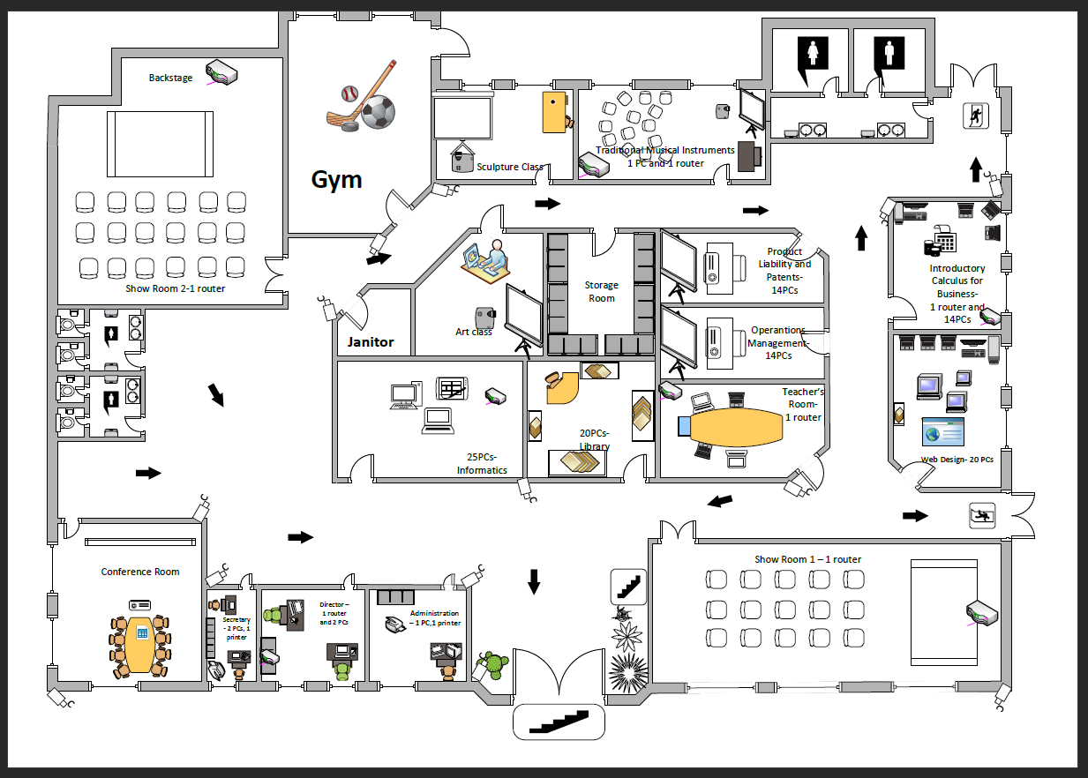
Main Building

Slide 8
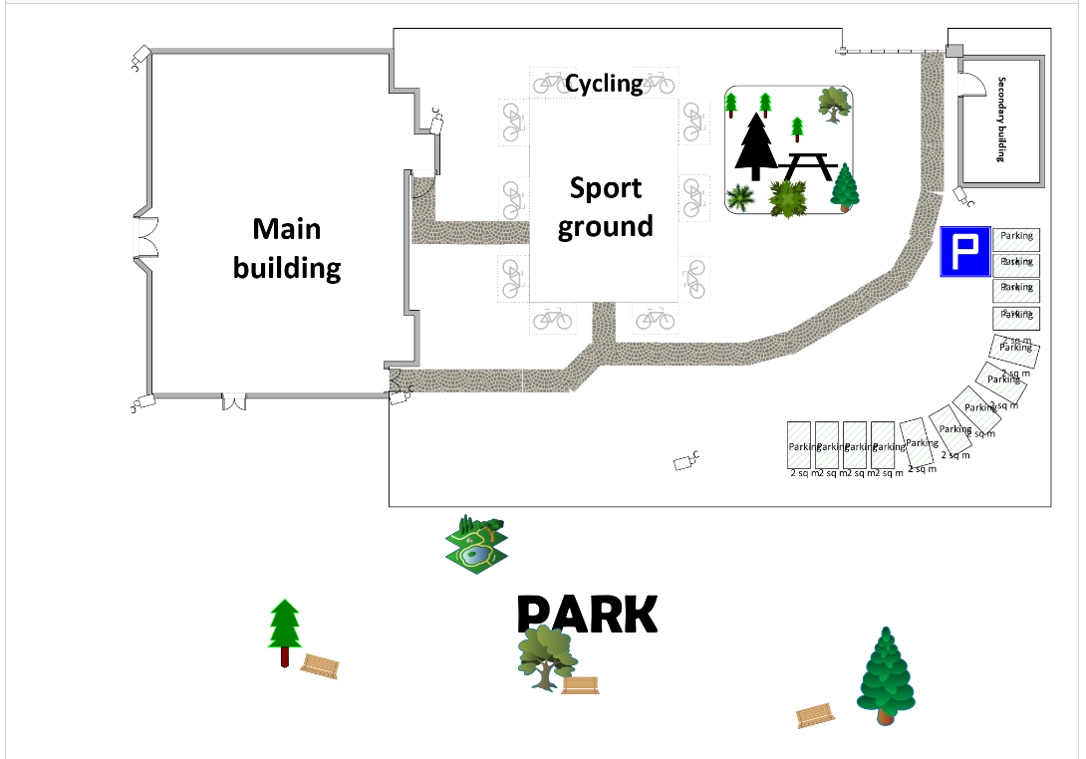
Lot Image

Slide 9



NETWORKING

Slide 10
Subnets and Hosts
How many subnets are necessary today ?
How many subnets are estimated to be necessary for the future?
How many hosts should have the largest subnet today? But in the future?

Slide 11
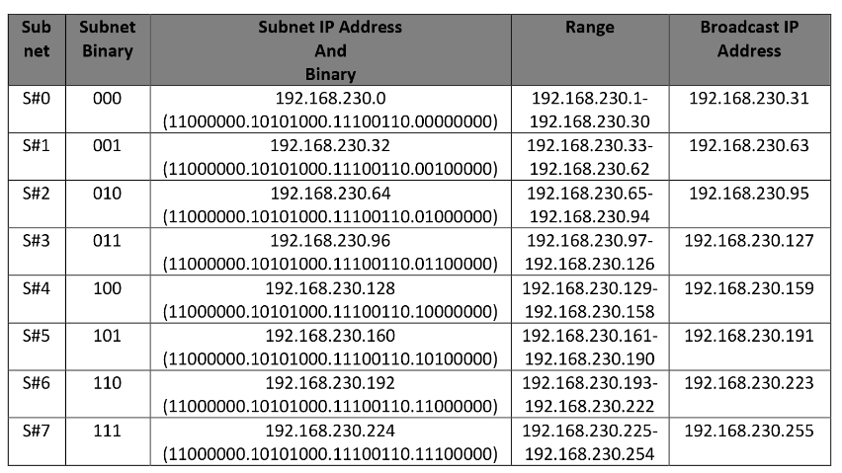
IP Addresses
The IP class that is going to be used is class C.
IP: 192.168.230.0
And the Subnet Mask is 255.255.255.224

Slide 12
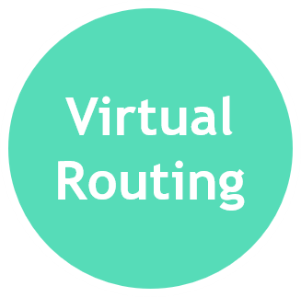



Slide 13
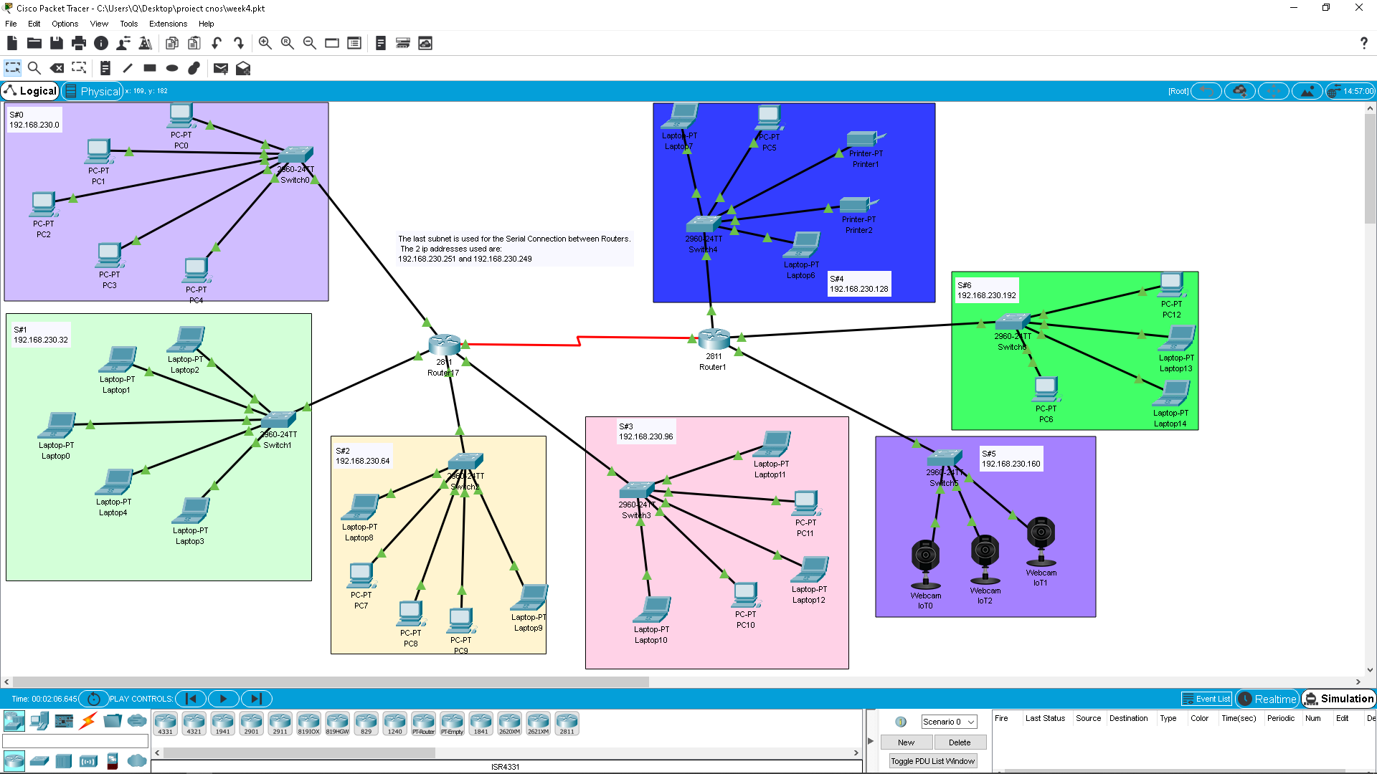
Virtual Routing

Slide 14

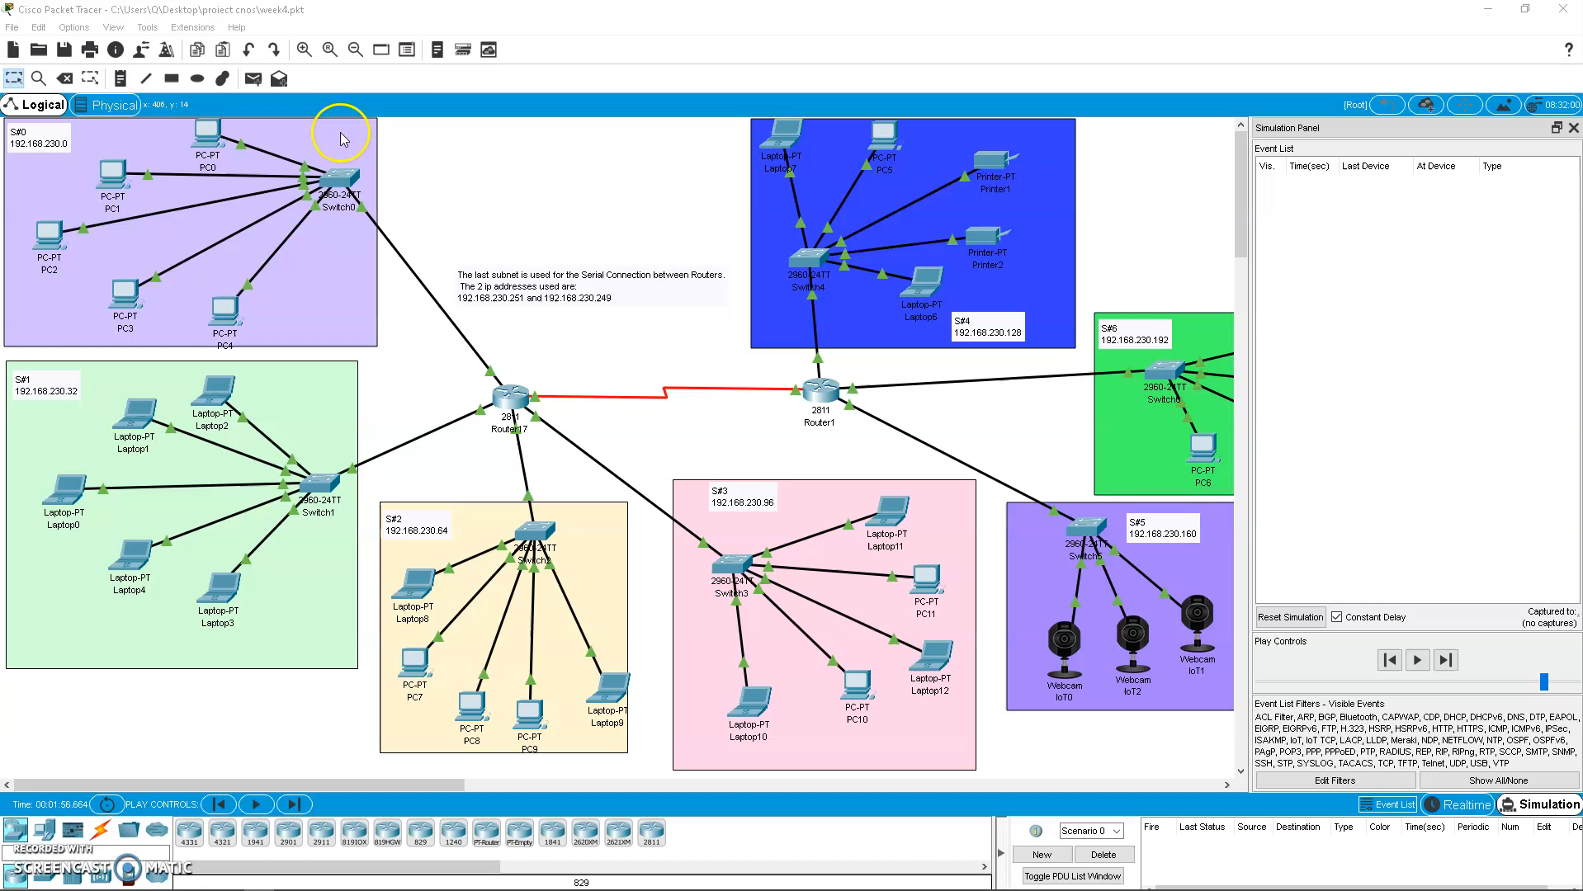
Simulation

Slide 15


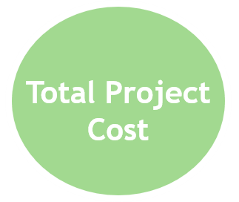


Slide 16
Organizational Details
For the project “Computer Networking of Children’s Palace” from Iasi the estimated work time is 4 weeks.
Workers necessary for the project with their salary:
2 Technicians with 1759 Lei/pers. (Net salary)
2 Engineers with 2724 lei/pers. (Net salary)

Slide 17
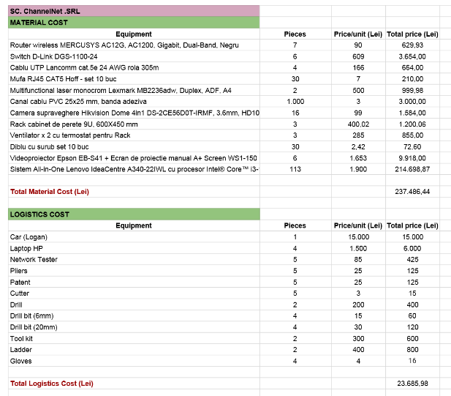
Materials and Logistics

Slide 18
Total Project Cost
As a summary for the budget we have:
Total material cost – 237.486,44 Lei
Work Labor – 15.400 Lei
Indirect Expenses – 27.657 Lei
Profit 20% - 56.108,74 Lei
Profit Tax 16% - 8.977,40 Lei
Meaning the Total Project Cost is 345.629,82 Lei

